Slide 1

Using CI / CD technology for python application development
Yevhenii Orlov

Slide 2


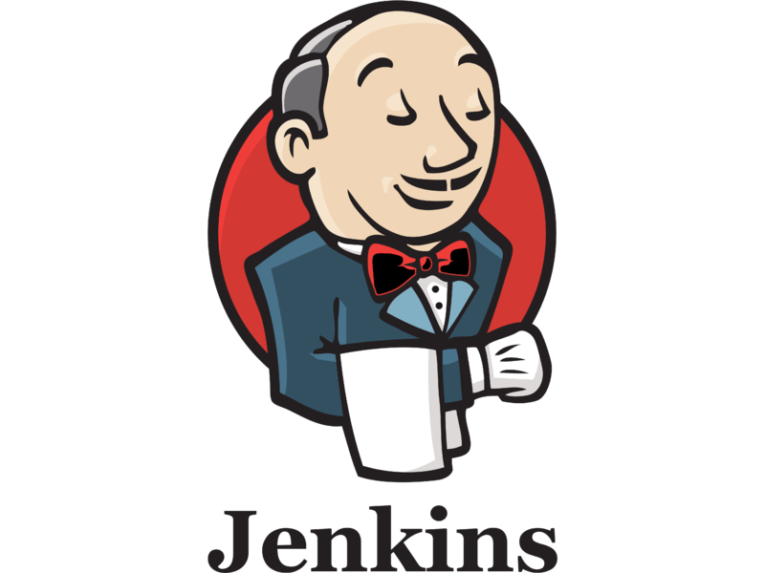

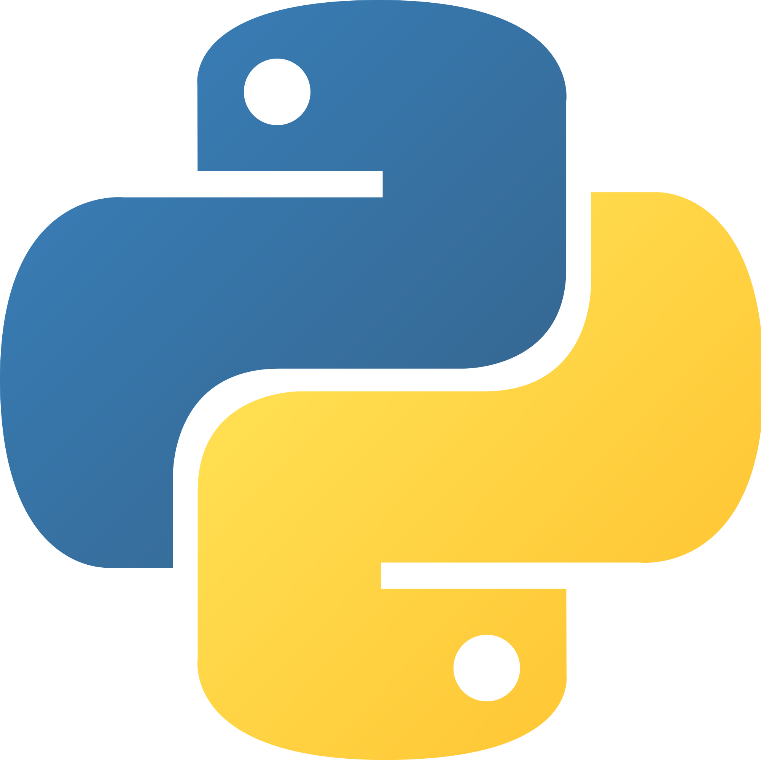

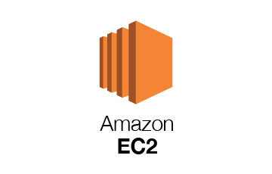

Purpose
Creation and implementation of continuous integration and delivery, using services such as:
GitHub is a web-based hosting service for version control using Git.
Jenkins is an open source automation server.
Ansible is an open-source software provisioning, configuration management, and application-deployment tool enabling infrastructure as code.
Amazon Elastic Compute Cloud (EC2) is a part of Amazon.com's cloud-computing platform, Amazon Web Services (AWS), that allows users to rent virtual computers.
Docker is a set of platform as a service products that use OS-level virtualization to deliver software in packages called containers.
Apache is a free and open-source cross-platform web server software.
Python is an interpreted, high-level and general-purpose programming language.
Mapquest Developer resource is a service with an API interface for plotting a car route.

Slide 3
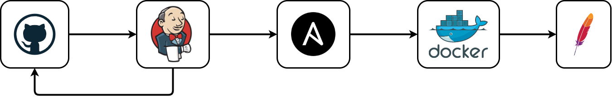
Project structure

Slide 4
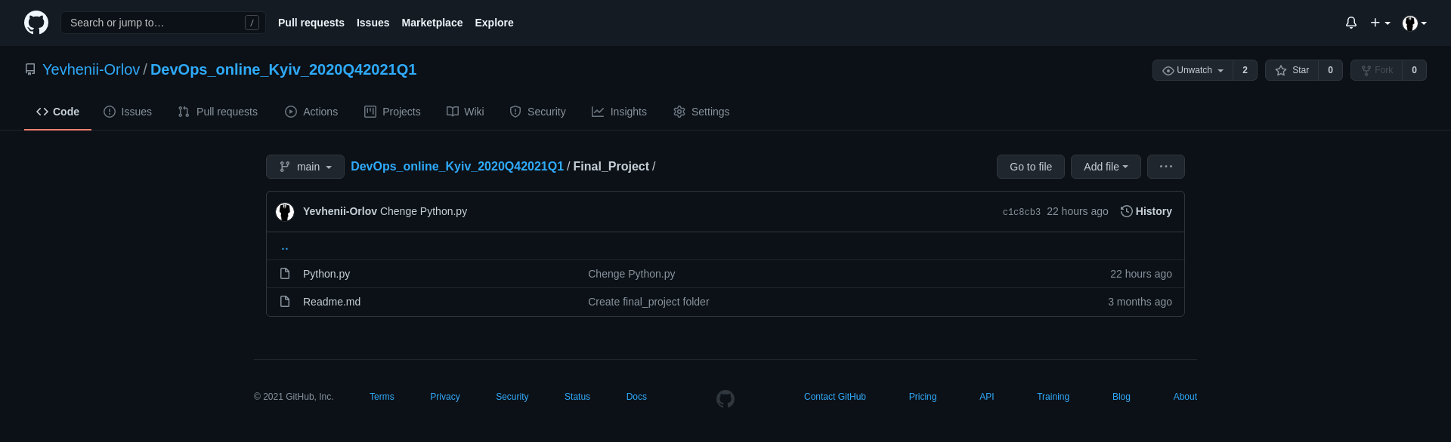
GitHub Repository

Slide 5
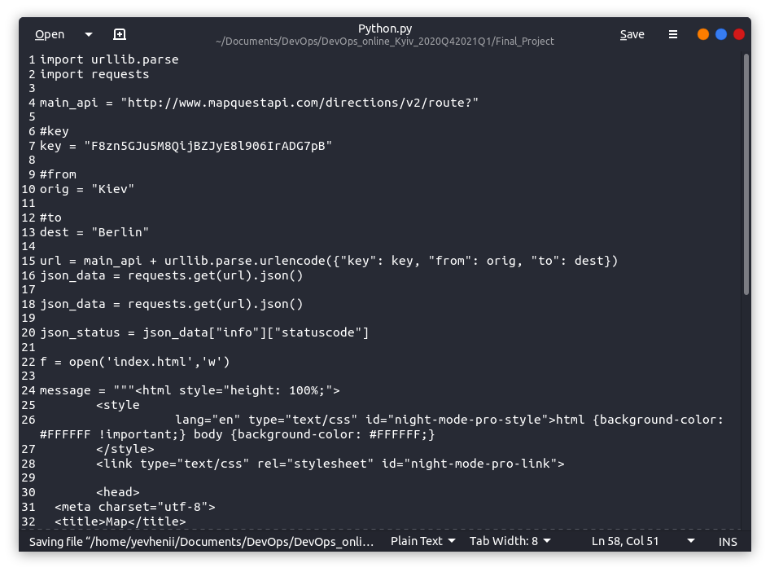
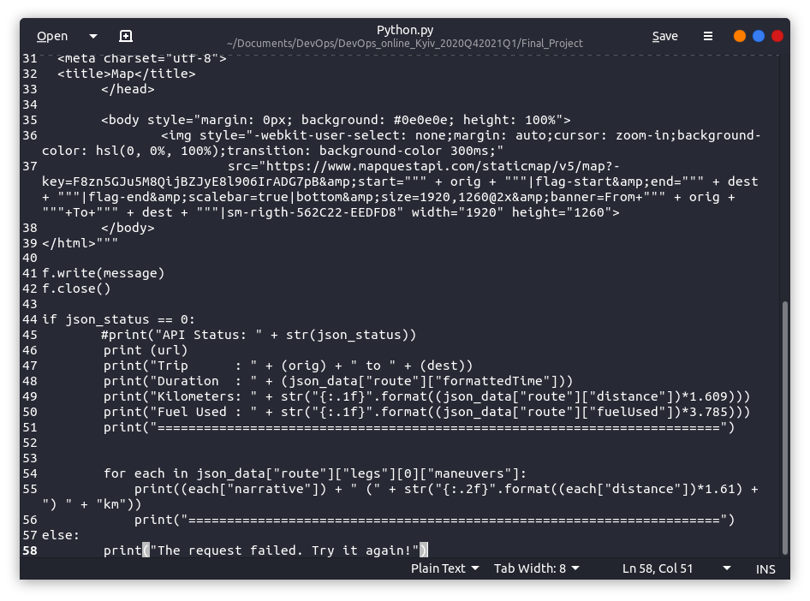
Python script

Slide 6
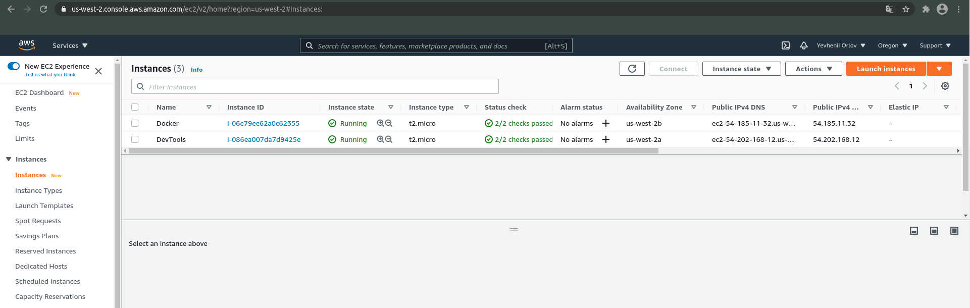
Amazon Elastic Compute Cloud (EC2)

Slide 7
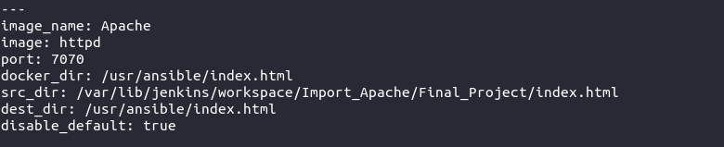
Ansible variables

Slide 8
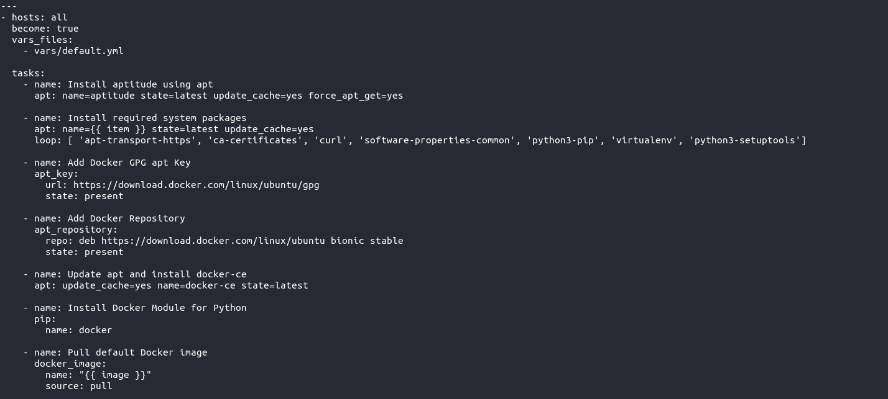
Ansible playbook

Slide 9
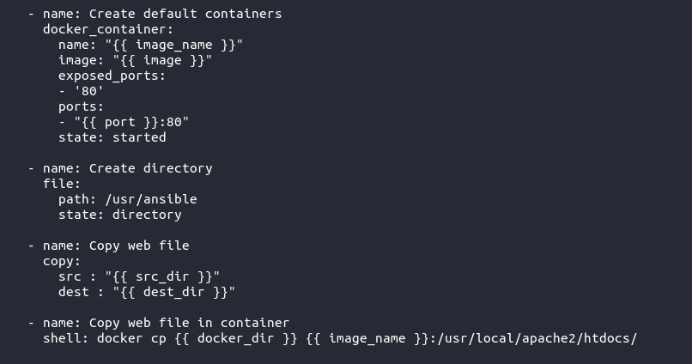
Ansible playbook

Slide 10
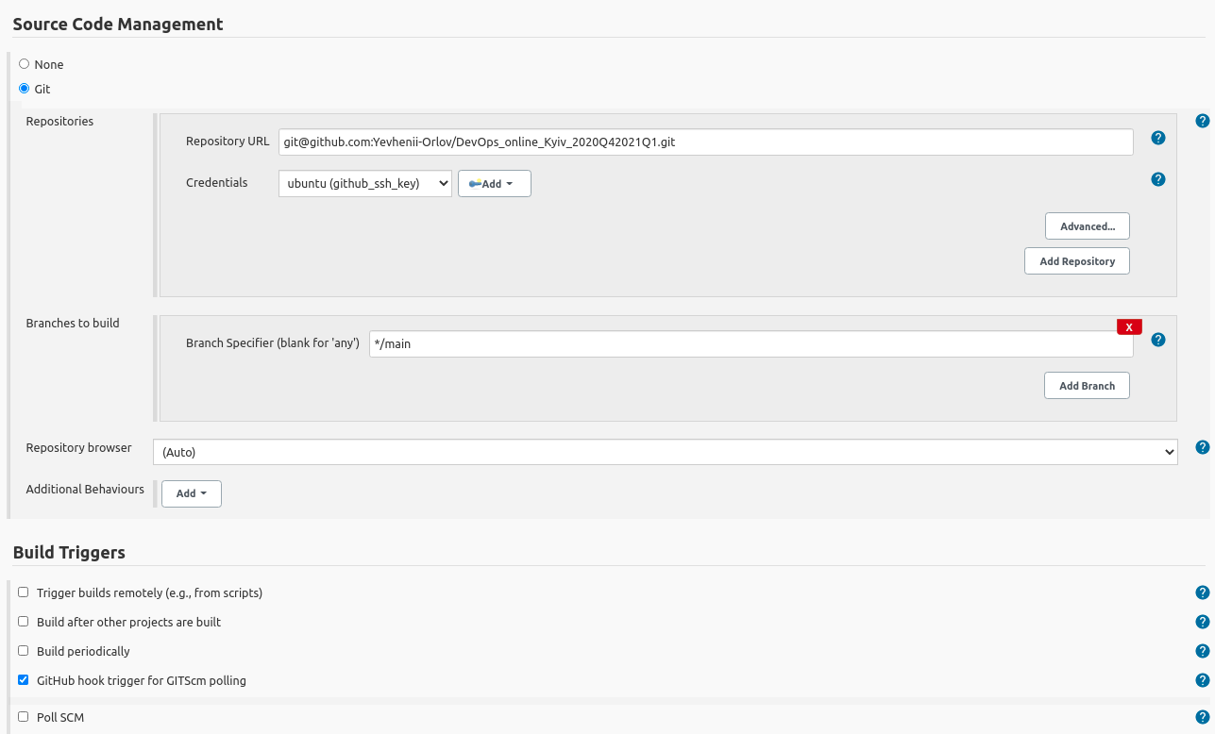
Jenkins webhook settings

Slide 11
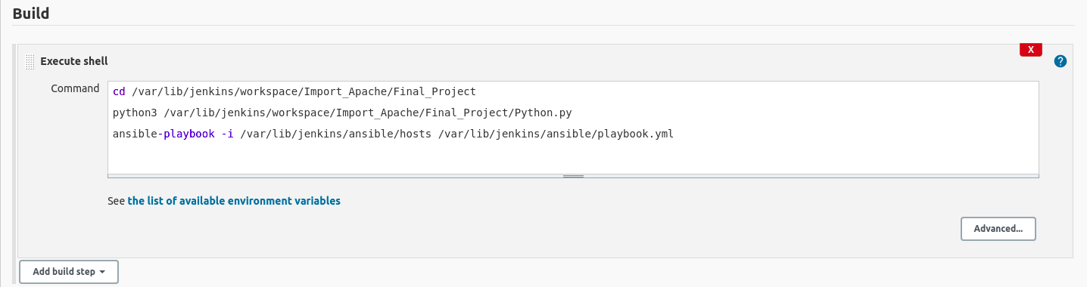
Jenkins executable code

Slide 12
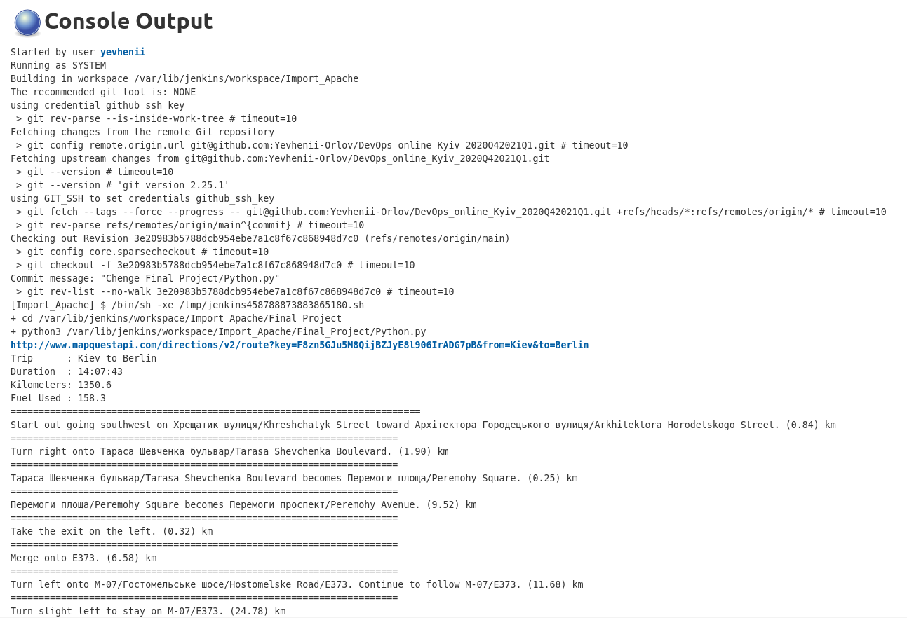
Jenkins console output

Slide 13
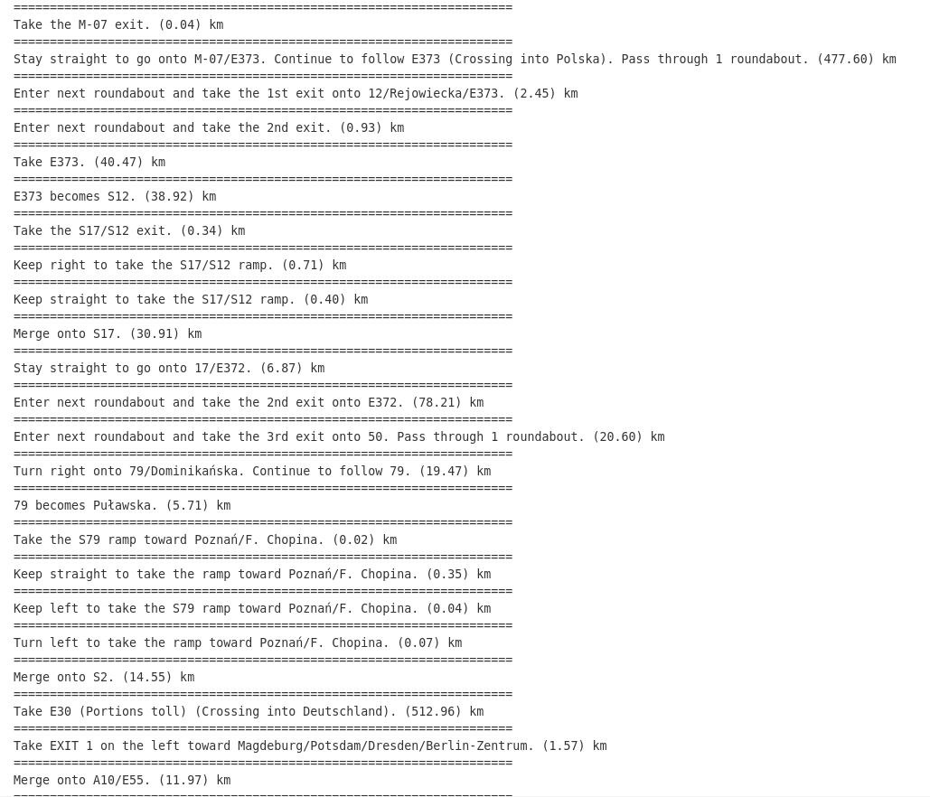
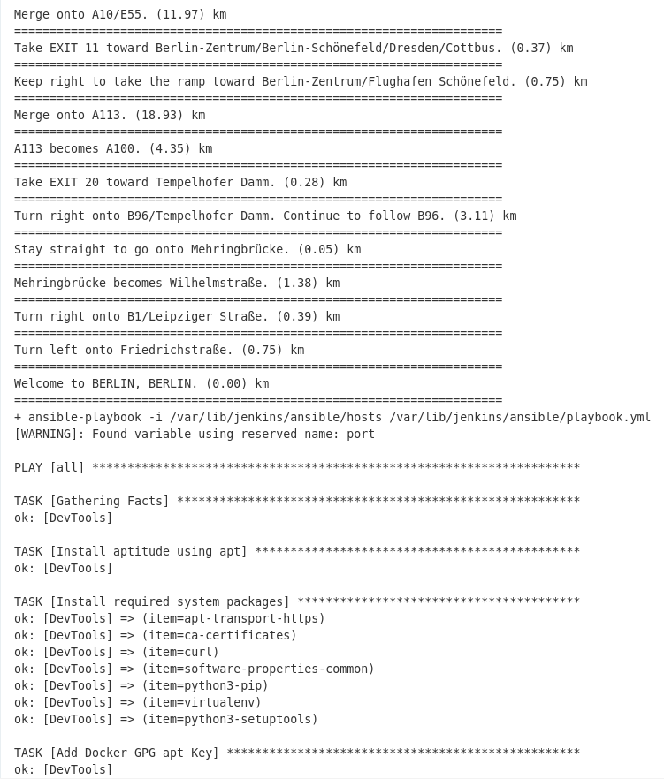
Jenkins console output

Slide 14
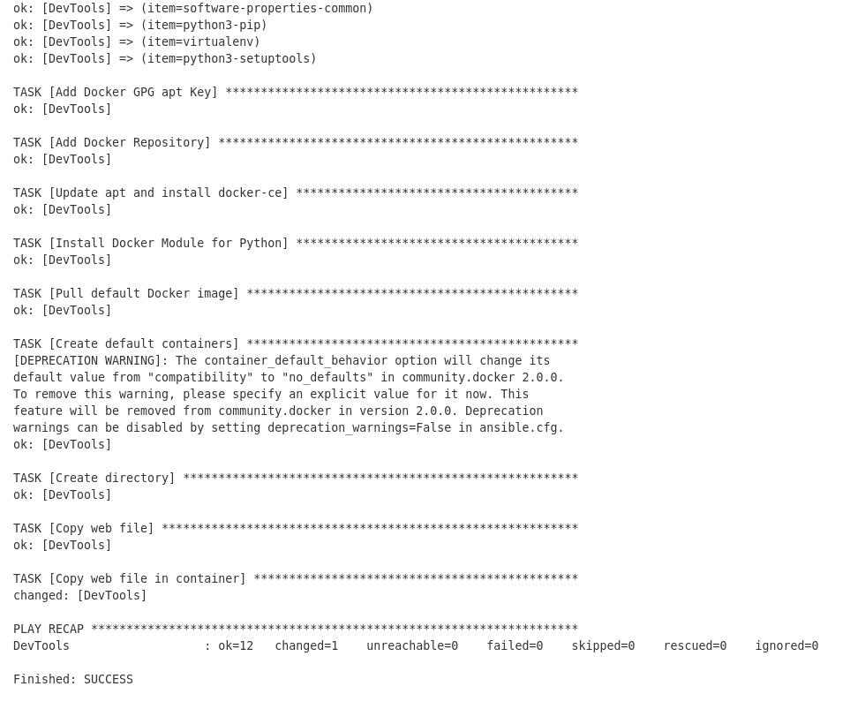
Jenkins console output

Slide 15
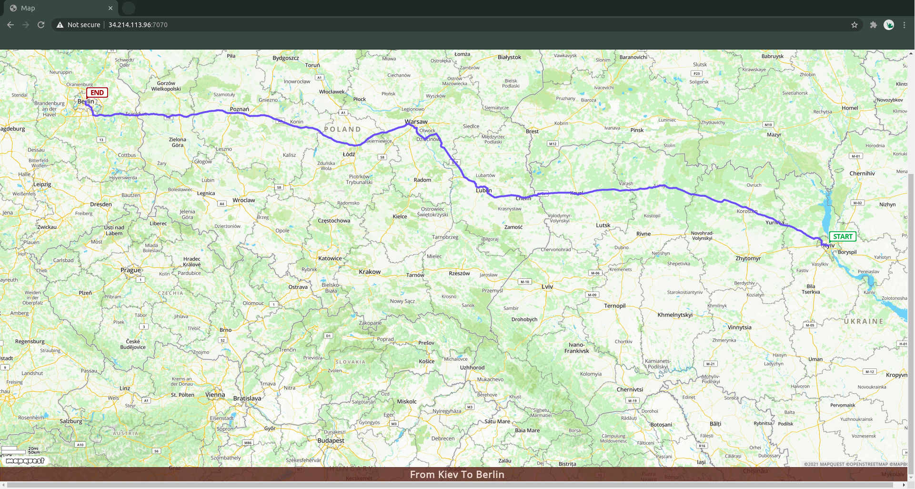
Result

Slide 16

Thank you for your attention!

